Slide 1
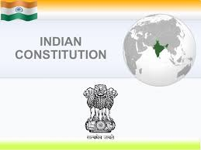

Slide 2
Constitution of India
Meaning of Constitution
Constitutional law
Constitutionalism

Slide 3
Meaning of Constitution

Slide 4
Almost everything we do is governed by some sets of rules
We need laws in society so our society can regulate and work properly
They are designed to protect us and our property and to ensure that everyone in society behaves the way that the community aspects them too

Slide 5
Laws tell us what to expect as a consequence of our actions and to keep the society together.
Without law there will be complete anarchy

Slide 6
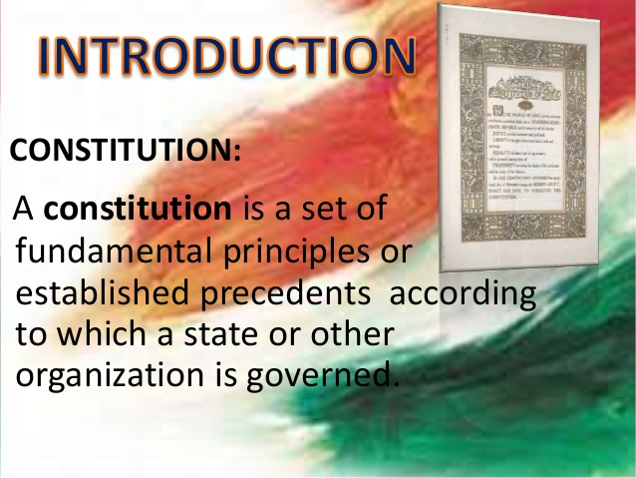

Slide 7
Constitution of a country lays down the basic structure of the political system under which its people are to be governed.
The supreme law of the land
It is the foundation and source of the legal authority underlying the existence of the state
It provides the framework for the organization of the government
It is a basic design, which deals with the structure and powers of the government. It also includes rights and duties of the citizens.

Slide 8
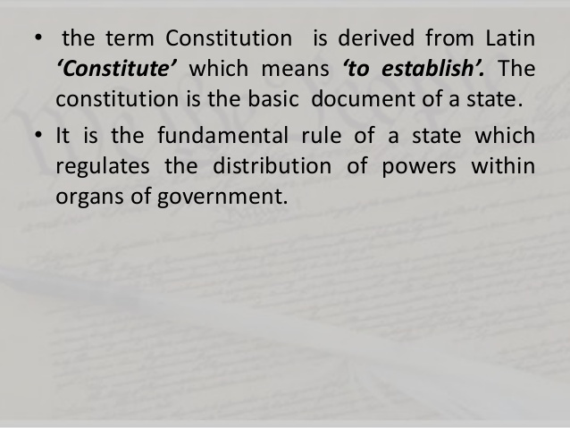

Slide 9
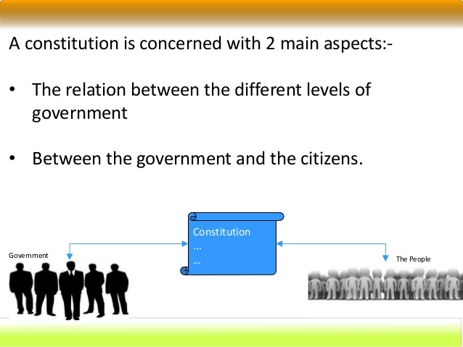

Slide 10
CONSTITUTIONAL LAW
Constitutional law is a body of law which defines the role, powers, and structure of different entities within a state, namely, the executive, the parliament or legislature, and the judiciary; as well as the basic rights of citizens

Slide 11
CONSTITUTIONALISM
Constitutionalism is concerned with both the framework as well as the spirit that breathes within the provisions in that framework
It is comprised of ideas and theories that essentially put limitations on political powers in general, and of the government’s way over citizens

Slide 12
It is a modern concept that desires a political order governed by laws and regulations.
It stands for supremacy of law not for an individuals
It insists limited government
It limits the arbitrary action of government

Slide 13
The principle that insists on organization and working of the state according to the constitution so that no organ and office holder of the state is allowed to use arbitrary power.
It not only provide framework of government but also prescribes powers of government and limits of those powers

Slide 14
System of government in which the governing power is limited by enforceable rules of law and the concentration of power is limited by various checks and balances so that the basic rights of individual and groups are protected

Slide 15
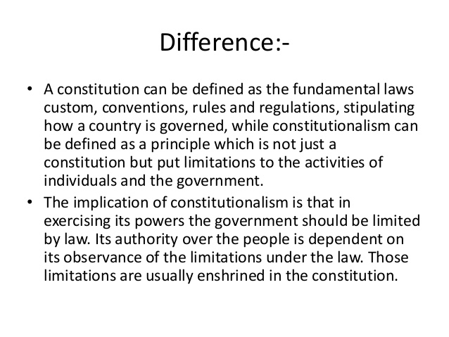

Slide 16
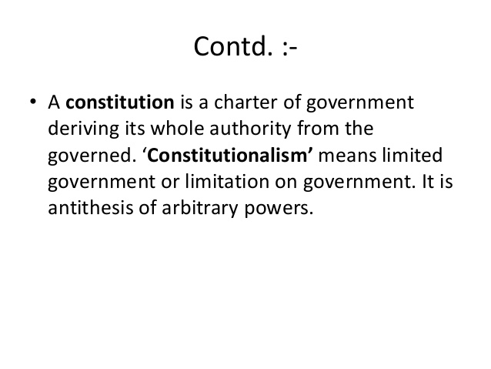

Slide 17
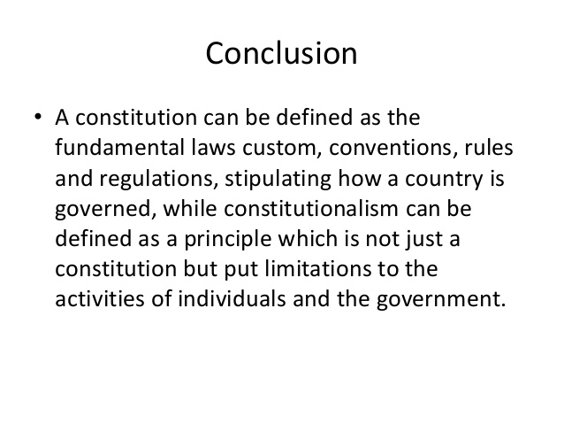

Slide 18
Historical Background of the Constituent Assembly

Slide 19
Constitution of India is the world’s longest written constitution in the world.
Constitution of India contains 448 Articles IN 25 Parts, 12 Schedule and 101 Amendments till date
It was M.N. Roy , who proposed the idea of Independent Constituent Assembly for India in 1934
But it was not accepted by the British Government

Slide 20
After world war 2, most of the Indian leaders resigned from their post to show their dissatisfaction, British brought August offer and Cripp’s Mission in 1940
This time it was rejected by Indians
They demanded to make Constituent Assembly only by the Indians
Finally Cabinet Mission Plan came in 1946

Slide 21
Mission was headed by Staford Cripp, A.V. Alexander and Pethick Lawrence
The total strength of the assembly was389
After partition only 299 were remained
It was partly elected and partly nominated body
In 1948 powers were transferred to Indians
First meeting was held in 9th December,1946
Dr. Sachidanand Sinha was the first temporary president of the Assembly

Slide 22
Second meeting was held on 11th December, Dr. Rajendra Prasad was elected as permanent president of the assembly
Third meeting was held on 13th December, Pt. Nehru brought Objective Resolution
It took 2 years ,11months and 18 days for the final draft
Initially there were total strenght was 389
But after partition 299 remained in India and 90 went to Pakistan( Muslim league)
On 29th August,1947 Drafting committee was constituted

Slide 23
Chairman of the Drafting committee was Dr. B. R. Ambedkar
After 3 drafts finally it was accepted on 26th Nov, 1949
It came into force on 26th Jan,1950

Slide 24
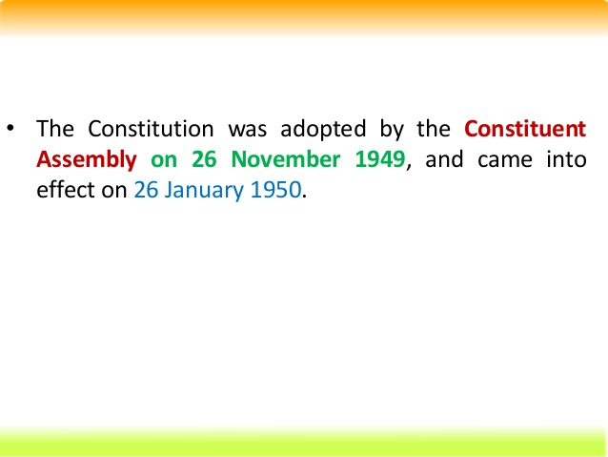

Slide 25
Government of India Act, 1935
This was the longest act so far
It is the main source for the constitution of India
Main sources of this act was Simon Commission and three Round Table Conferences (RTC)

Slide 26
FEATURES OF THE ACT
Formation of All India Federation
Powers will be divided into centre and units
Units will be including Provinces( states) and princely states( ruled by kings)
Princely did not participated
Three list were made and items were divided among them
1. federal list ( for centre with 59 items)
2. provincial ( state with 54 items)
3. concurrent ( for both with 36 items)

Slide 27
Central Government

Slide 28
If the item is not included in any of the list , this will come under Residuary powers.( decided by the Viceroy)
Abolition of provincial dyarchy and introduction of dyarchy in the centre
Dyarchy was introduced at central level
It was divided into two parts

Slide 29
RESERVED
TRANSFERRED
Reserved: administrated by the Viceroy and he can take decisions without advising anyone
Transferred: he has to take advice of others before taking any decisions

Slide 30
Government
1.Central( center)
2. Provincial (state)
Initially dyarchy was in state
Dyarchy ( all subjects will be divided into two)
Reserved ( without consulting)
Transferred (with consultation)

Slide 31
Provincial Autonomy:
Most remarkable feature was provincial autonomy
With the abolition of dyarchy at provivces,the entire provincial administration was instructed to the responsible ministers, who were controlled and removed by the provincial legislatures

Slide 32
Establishment of Federal Court
This act provided the Federal Court to resolve the disputes related to Federal matters( matters between centre and state as well as among states)
The provisions were made for filling the appeal from High Court to Federal Court and from Federal to Privy council( in England)
Today , Federal Court is known as Supreme Court of India

Slide 33
Abolition of Indian Council
Under this act the Indian Council was replaced which was according to 1858 act by the Advisory Council
Secretary of state was provided with a team of Advisors.

Slide 34
Reorganizes the Provinces
Separation of Sind from Bombay
Splitting Bihar and Orissa into separate provinces
Complete separation of Burma from India

Slide 35
Estalishment of RBI
Under this act RBI ( Reserve Bank Of India) was established to control the currency of the country
Other features
Extended franchise
Under this act first time direct elections were done and about 10% of the population got the voting right
This act provided separate electorate for depressed classes e.g. SC , LABOURS ETC

Slide 36
INDIAN INDEPENDENCE ACT, 1947
BACKGROUND
IN 1946,Cabinet Mission came to form constitution of India
On 20th feb, 1947, British Prime Minister Clement Atlee annonuced that They will rule max till 30 June,1948
On 3rd June ,1947, Lord Mountbatten brought Partition plan , which was accepted by both Congress and Muslim League
To implement this plan in action an Act was passed , this is known as Indian Independence Act,1947

Slide 37
Features
The date for transfer of powers was decided on 15th August, 1947
Now India was a Soverign state
Creation of two independent states India and Pakistan was done
Sind decided to join the Pakistan state
Princely states were also free to join any state or remain independent, they choose independent

Slide 38
The authority of British crown over the princely states ( British Paramounty) was removed.
Abolished Viceroy , each state has Governor General post, which is appointed by British crown
British Monarch would no longer use the title “ Emperor of India”
After the states were created, all acts of the British Parliament were removed
Secretary of state( SOS) was abolished

Slide 39
ENFORCEMENT OF THE CONSTITUTION
After three drafts the constitution was adopted on 26th November, 1949
Major part of the constitution was enforced on 26th Jan,1950
Some articles related to elections, citizens, parliament like 5,6,7,8,9,60,364,366,367,380,388,391,392 and 393 were came into force only on 26th Nov, 1949
Total Articles were 395 and 8 Schedules

Slide 40
Salient features of the Constitution
1.Lengthiest and Written Constitution:
Constitution of India is the lengthiest in the world as it has many articles
Originally it had 22 parts, 395 Articles and 8 Schedules. Now it has 25 parts,448 Articles and 12 Schedules
It is a single constitution for both center and state

Slide 41
2. Unique blend of rigidity and flexibility
In terms of flexibility , we can make changes but it needs strong majority in terms of rigidity
3 .Beautiful Patchwork
It has been inspire and derived from various sources. Best features of different constitutions have been incorporated in our constitution . e.g. fundamental rights from US , few words like Republic, Equality, etc from France, Procedures for Amendments from South Africa, Fundamental duties from Russia

Slide 42
4. Parliamentary form of Government
Indian constitution provides parliamentary form of Government .
President is the nominal head of the state.
In actual practice, the Prime Minister and Members of council ministers run the government
5. Fundamental Rights
These are mentioned in Part III ( From A 12 to 35)
Source is USA ,

Slide 43
Initially there were total 7 Fundamental Rights
Now, one is shifted to normal rights so total 6 is remained
Right of equality
Right of Freedom
Right against Exploitation
Right of Freedom of Religion
Right of Culture and education
Right of Constitutional remedies
These are Justiciable

Slide 44
6.Fundamental Duties
These are mentioned in Part IV A
It is derived from Russia
Initially there were 10 fundamental duties and one is added new
Now total 11 fundamental duties in our constitution
These are non Justiciable

Slide 45
7. Directive Principle of State Policy(DPSP)
It is taken from Ireland
It explains the welfare ( social and economic) of the state
Any state and center can make laws on the basis of DPSP
8.Single Citizenship
It provides single citizenship in all states of the country

Slide 46
9. Universal Adult Franchise
Under the constitution each of 18 years or above has right to vote
Initially the age limit was 21 years
10.Integrated and Independent Judiciary
Our judiciary does not work under any group
Integrated means all subordinate court , High Court and Supreme Court are inter connected

Slide 47
11. Emergency Provisions
It was taken from GOI,1935
There are three types of Emergencies
National (A 352)
State(President Rule)(A 356)
Financial(A360)
12.Independent bodies
The constitution provides some independent to perform some specific functions alloted to them

Slide 48
The important bodies are
Election Commission of India (A 324)
CAG( Controller , Auditor General)(A 148)
Union and State Public Service Commissions(UPSC & SPSC) (A315)
13. Federal system but unitary Bias( Quasi federal)
Our constitution is mixture of federal and unitary system
In our nation center is very strong

Slide 49
Some features of unitary system e.g. Single citizenship, appointment of Governors etc
Some federal features in our constitution e.g. written single constitution
14. Three tier Government
In our constitution , initially there were two Governments e.g. Central and State Government
After Amendment, three levels were introduced e.g. Central , State and Local ( Panchayat or Municipality)

Slide 50
PREAMBLE
The term Preamble refers to the Introduction or Preface to the Constitution
It is a kind of Summary or Essence of the constitution
The American constitution was the first to begin the Preamble

Slide 51
The Preamble gives an idea about the following
1. Source of the Constitution
2. Nature of Indian state
3. Objectives of the Constitution
4.Date of Adoption

Slide 52
1. Source of the Constitution
“We the People of India” line is mentioned in our Preamble
It means that People are the main supreme Power ( Source)
Our constitution is by the people and for people

Slide 53
2. Nature of Indian state
Sovereign
Socialist
Secular
Democratic
Republic

Slide 54
Sovereign
India is a sovereign country ( complete independent )
It is free from any other outside power
It has a free Government which is elected by its own people
No outside power can dictate the government
Socialist
It means economic philosophy
In India Mixed Economy is present ( both private and public sector can work together)

Slide 55
Secular
It means all Religions have same status and support from the Government
Democratic
It means supreme power is in the hands of people
A Government is formed by the will of the people
The ruler is elected by the people and are responsible to them

Slide 56
Republic
As opposed to the Monarchy( based on heredity), in India Head of the State is elected member.
In India President Head of the state.
It is not hereditary post, every citizen of India is eligible for the post.

Slide 57
3. Objectives of the Constitution
Justice
Liberty
Equality
Fraternity

Slide 58
Justice
It means fairness in the treatment of people
It may be of three types
SOCIAL
ECONOMIC
POLITICAL
Social : color, caste ,religion ,sex etc
Economic: money ( Rich and Poor)
Political: equal right of voting

Slide 59
Liberty
It means absence of restraint on the activity of individual
It is of five types
Thought
Expression
Belief
Faith
Worship

Slide 60
Equality
It means absence of special privilege
It is of two types
Status
Opportunity

Slide 61
Fraternity
It means feeling of brotherhood
It insures two basic things
Dignity of Individual
Unity and Integrity of the Nation

Slide 62
4. Date of Adoption
Date of adoption of Constitution is 26th November, 1949
But most of the Articles came into force on 26th Jan, 1950
Preamble is adopted on 26th November, 1949

Slide 63
FUNDAMENTAL RIGHTS
These are mentioned in Part III ( A 12 TO A35)
Source is USA ( Bills of Rights)
These are Justiciable
These are provided to secure our Democracy
It is helpful to remove dictatorship
Initially there were total 7 Fundamental Rights
Now , total six fundamental rights are present. Right of Property was removed from the list.

Slide 64
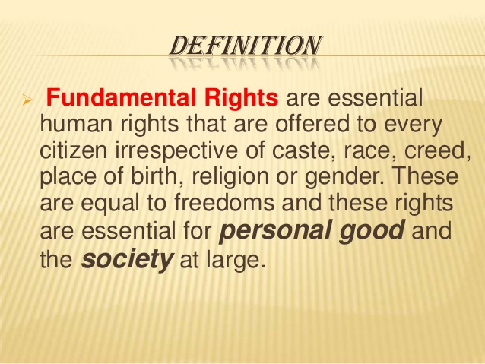

Slide 65
They are not absolute ( have some restrictions)
Governed by Supreme Court
Most of the rights gets suspended during National Emergency

Slide 66
There are total 6 fundamental Rights
Right to Equality( A 14-18)
Right to Freedom ( A 19-22)
Right Against Exploitation ( A 23-24)
Right to freedom of Religion ( A 25-28)
Cultural and Educational Right ( A 29-30)
Right to Constitutional Remedies ( A 32)

Slide 67
1. Right of Equality
It is mentioned from A (14 -18)Some important points mentioned are as follows
1. Equality before law and equal protection of law
It means all citizens are equal, no person is above the law
There will be equal treatment under equal circumstances( Presidents and Governors are excepted)

Slide 68
2.Prohibition of Discrimination
State can not discriminate anyone on the basis of caste, Race, Religion, Gender, place of birth
3. Equality of opportunity in Public employment to all citizens
All citizens are eligible for the public employments. Exceptions ( Backward classes)
4. Abolition of Untouchibility
It prohibits the practice of untouchibility in any form e.g. refusing to enter in any worship area to a person

Slide 69
5. Abolition of Titles:
Prohibits to use any title like Maharaja, Bharat Ratna prefix or suffix

Slide 70
2. RIGHT TO FREEDOM
It is mentioned in the A 19 TO22
It explains the freedom related to the following points
1. freedom of speech and Expression
2. Assemble peacefully without arms
3. To form any Association
4. to move freely throughout the country
5.to settle in any part of the country
6. Practice any profession

Slide 71
Protection in respect of conviction of offence
It tells the protection to the accused person in some circumstances
Protection of life and personal liberty
No person shall be deprived of his life or personal liberty except by the law
Right to education
State shall provide free and compulsory education to all children between age of 6- 14 years

Slide 72
Protection against Arrest and detention
It tells about the conditions to arrest and detention

Slide 73
3. RIGHT AGAINST EXPLOITATION
It is mentioned in A23 and 24
it covers following points
1. Prohibition of Traffic in Human beings & forced labor
If it happens it is punishable
Traffic in human means selling of human beings
2. Prohibition of Employment of children in factories

Slide 74
It explains that children below age of 14 years can cot work in any industry ( mainly Hazardous)
There is also an Act related to it i.e. Child Labour Act,1986)

Slide 75
4. FREEDOM OF RELIGION
According to the constitution all religions are equal before the state. No preference will be given to a particular religion.
Following points are covered
Freedom of conscience & free profession, practice& propagation of religion
Freedom to profess any religion
Freedom to practice any religion
Free to tell others about the religion

Slide 76
Freedom to Manage religion affairs
It explains right to establish& maintain religious and charitable institutes
Right to manage its own affairs in matter of religion( no interference of the state)
Freedom from Taxation for promotion of religion
Freedom to attend religious institutions

Slide 77
5.CULTURAL AND EDUCATIONAL RIGHT
It is under A 29 & 30
Protection of interest of Minorities
Any citizen residing in any part of the country can conserve their language, script and culture
No citizen deny admission in any educational institute , maintained by state government on the basis of religion, caste, race and language

Slide 78
All minorities ( Religious and Linguistic) can setup their own educational institutes to preserve and develop their own culture.

Slide 79
6.Right to Constitutional Remedies
It empowers the citizens to move a court of law in case of any violation of the fundamental right
This can be done by several methods, court can issue various kinds of writs. These are
Habeas Corpus
Mandamus
Prohibition
Certiorari
Quo- Warranto

Slide 80
Fundamental duties

Slide 81
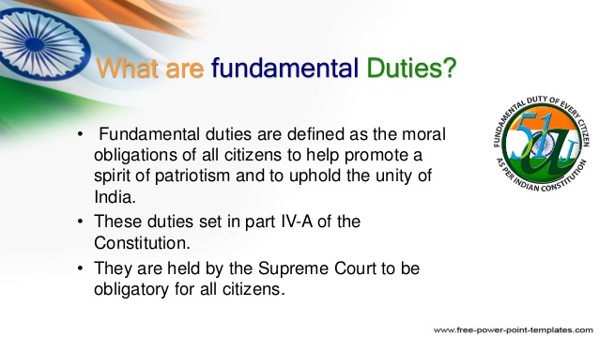

Slide 82
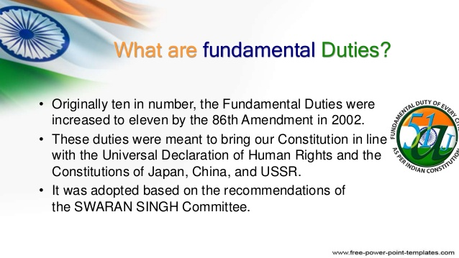

Slide 83
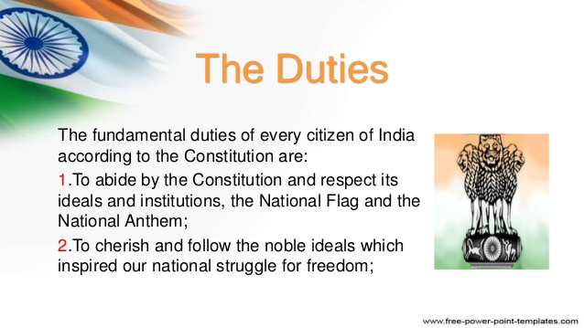

Slide 84
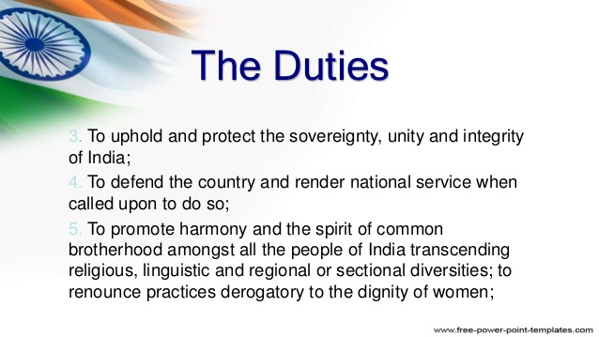

Slide 85


Slide 86


Slide 87


Slide 88
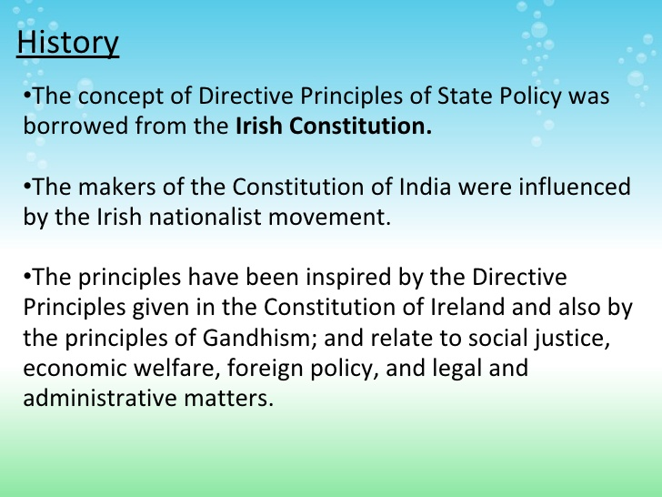

Slide 89
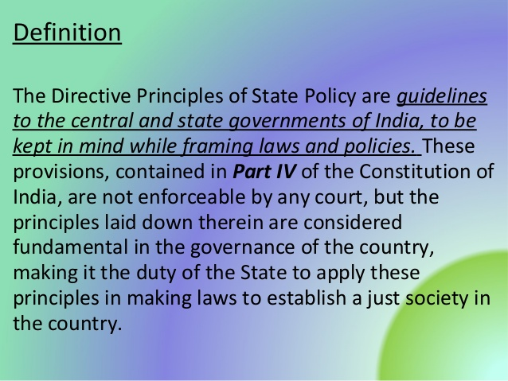

Slide 90
Parts
All principles are divided into three parts
Socialistic Principle
Gandhian Principle
Liberal and intellectual Principles

Slide 91
Socialistic Principles
To promote welfare of people and minimize inequality
Adequate means of livelihood for all citizens
Equal distribution of resources
Prevention of concentration of wealth
Equal pay for equal work for men and women
Prevention of health and strength of the worker and children against abuse

Slide 92
Opportunity for health development of children
To promote equal Justice and provide free legal Aid to the poor
To secure right to work, to educate , public assistance in case of old age and sickness
To make provisions for better working conditions and Maternity Relief
To secure living wages, decent standard of life equal opportunity for workers
To secure participation of workers in Management of industries

Slide 93
To raise the level of Nutrition and standard of living for better public health
Gandhian policies:
To organize village Panchayat and give necessary powers
To promote Cottage industry in Rural areas
To promote Cooperative Societies
To promote education and economic interest of Sc/ST/ weak sections
Prohibition of intoxicating drinks and drugs
To prohibit slaughtering of cows and calves

Slide 94
Liberal and Intellectual Principles
Uniform civil court through out the country
Provide childhood education till the age of 6 years
Organize agriculture into Modern and scientific line
To protect and improve wildlife and forest
To protect Monuments and places of National importance
To promote International Peace

Slide 95
PARLIAMENTARY SYSTEM
It is also known as Cabinet Government
It is in which Executive is responsible to the Legislature
It was originated in Britain

Slide 96
Features
1. Dual Executive
There are two Executives
Real
Nominal
The President is the Nominal Executive and PM is the Real Executive
The President is the Head of the State and PM is the Head of the Government

Slide 97
2. Majority Party Rule
The party or a group of parties secure a majority in the Lok Sabha form the Government
The leader of the party is appointed as PM by the President
Other Ministers are appointed by the President on the advice of PM

Slide 98
3. Collective Responsibility
It is a very important principle
It is a BEDROCK principle of the parliamentary system
The Ministers are collectively responsible to the Parliament

Slide 99
4. Political Homogeneity
Usually the members of council of ministers belong to the same party, hence share the same political ideology
If coalition , members are bound to the consensus.
5. Double Membership
Ministers are the member of both the Legislature and executive

Slide 100
6. Dissolution of the lower House
Lower house (Lok Sabha) can be dissolved by the President on the recommendation of PM
7. Secrecy
Ministers work on the principle of secrecy, cannot divulge the information about the policies and decisions

Slide 101
FEDERAL SYSTEM
It is a system in which powers are divided and shared by central and state Government
Features
Dual Polity: powers are divided into central and state level
Division of Powers: Matters related to Defence, Currency and foreign are controlled by the central Government

Slide 102
Matters related to Agriculture, Health and public orders are controlled by State only
Supremacy of Constitution
Constitution is at the top. Both governments will follow the laws mentioned in the constitution
Written Constitution: as in federal system, there are two governments.
Both governments have the same rules and regulations as mentioned in the constitution.

Slide 103
Rigid Constitution
The process for amendment in the constitution is very complicated
No government can bring any changes easily
Different kinds of majority is required for passing the Bill
Independent Judiciary
There is a free Judiciary , which will give decisions independently.
There should not be any favour due to any pressure

